Slide 1
Structured Expert Elicitation – Example Training Deck
Last updated: November 2023

Slide 2
Using this deck
This slide deck is intended to be used as a basis for live, facilitated training of experts participating in a structured expert elicitation exercise.
Slides are intended to be adjusted according to individual needs.
Information is provided on four key methods:
Option 1: Chips and bins
Option 2: Quartiles
Option 3: Tertiles
Option 4: Bisection
Slides relating to methods not being used in your exercise should be deleted

Slide 3
TOPIC | SLIDE NO.
Study Background | 4
Structured Expert Elicitation | 8
Practice Example | 21
Questions and Evidence Base | 48
Q&A | X

Slide 4
TOPIC | SLIDE NO.
Study Background | 4
Structured Expert Elicitation | 8
Practice Example | 21
Questions and Evidence Base | X
Q&A | X

Slide 5
Study objectives
Summary of study objectives to be added here

Slide 6
Study purpose
Summary of motivations for the study to be added here

Slide 7
How will the results be used?
Summary to be added here

Slide 8
TOPIC | SLIDE NO.
Study Background | 4
Structured Expert Elicitation | 8
Practice Example | 21
Questions and Evidence Base | 48
Q&A | 53

Slide 9
Structured Expert Elicitation is a method for obtaining judgements from experts that minimizes bias and may reflect uncertainty.
Obtaining judgements from experts
Structured expert elicitation
Expert opinion
Obtaining beliefs from experts in a quantitative or statistical form, for example, as probability distributions for uncertain quantities.
Obtaining qualitative information from experts.

Slide 10
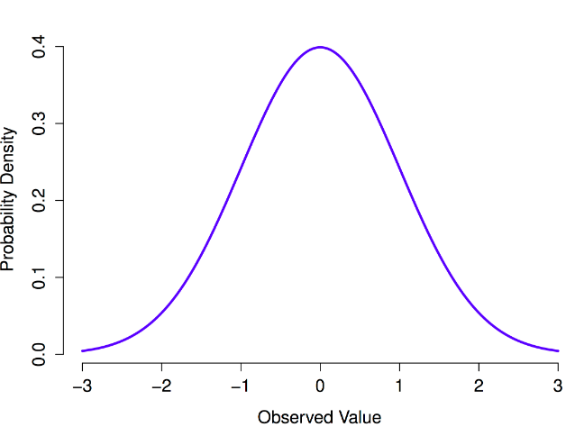
Probability distributions in SEE represent subjective uncertainty, not variability.
A COIN TOSS
Frequency probability based on discrete data
PROBABILITY
OUTCOME
COMMUTE TIME
Frequency probability based on continuous data
REPRESENTS
VARIABILITY
WINNING TIME IN THE PARIS OLYMPICS MEN’S 100m FINAL
Subjective probability based on continuous data and prior beliefs
REPRESENTS
UNCERTAINTY
SEE = Structured Expert Elicitation
Notes:
To understand what probabilistic elicitation is, we need to understand the difference between frequency and subjective probability.
Taking a coin toss as an example, we can estimate the probability of heads or tails based on previous coin tosses.
If we look at an example with continuous data, e.g. time taken commuting to the office, previous data can be used to generate a probability distribution.
Where a parameter is (i) unique and therefore cannot be repeated, and (ii) uncertain, e.g. predicting the winning time in the Paris Olympics men’s 100m final, we need a new way of thinking about probability – subjective probability.
This can be based on both existing data (e.g. previous 100m final times, recent times of the expected runners in the final, track conditions), but may be updated based on prior beliefs – a Bayesian approach.
There is an important distinction here between variability within a dataset (as in the first two cases) and uncertainty surrounding a unique value of a parameter (as in the final case).

Slide 11
How is Structured Expert Elicitation conducted?
Step 1: Design protocol
Step 2: Identify, recruit, train and brief experts
Step 3: Elicit individual judgements, feedback and fitting
Step 4: Consensus workshop OR Aggregation via linear opinion pooling [delete as appropriate]
Step 5: Analysis (statistical and/or qualitative) and reporting

Slide 12
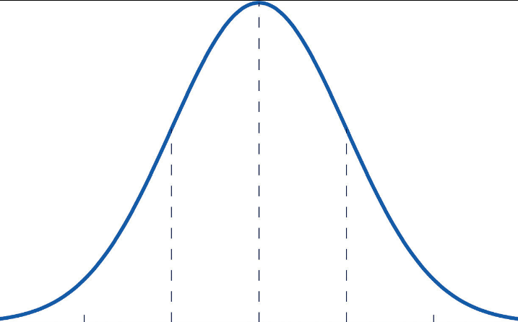
You will first be asked for your plausible limits for each quantity of interest.
LOWER PLAUSIBLE LIMIT (L)
A value such that you believe that there is a 1% probability that the true value is less than L
UPPER PLAUSIBLE LIMIT (U)
A value such that you believe that there is a 1% probability that the true value is greater than U
Probability density
L
U
Quantity of interest
Why start with plausible limits?
Minimizes the bias of over-confidence – not assigning enough probability to extreme values
Minimizes the bias of anchoring – assigned too much credibility to a value already in the expert’s mind
Provides bounds to the uncertainty

Slide 13
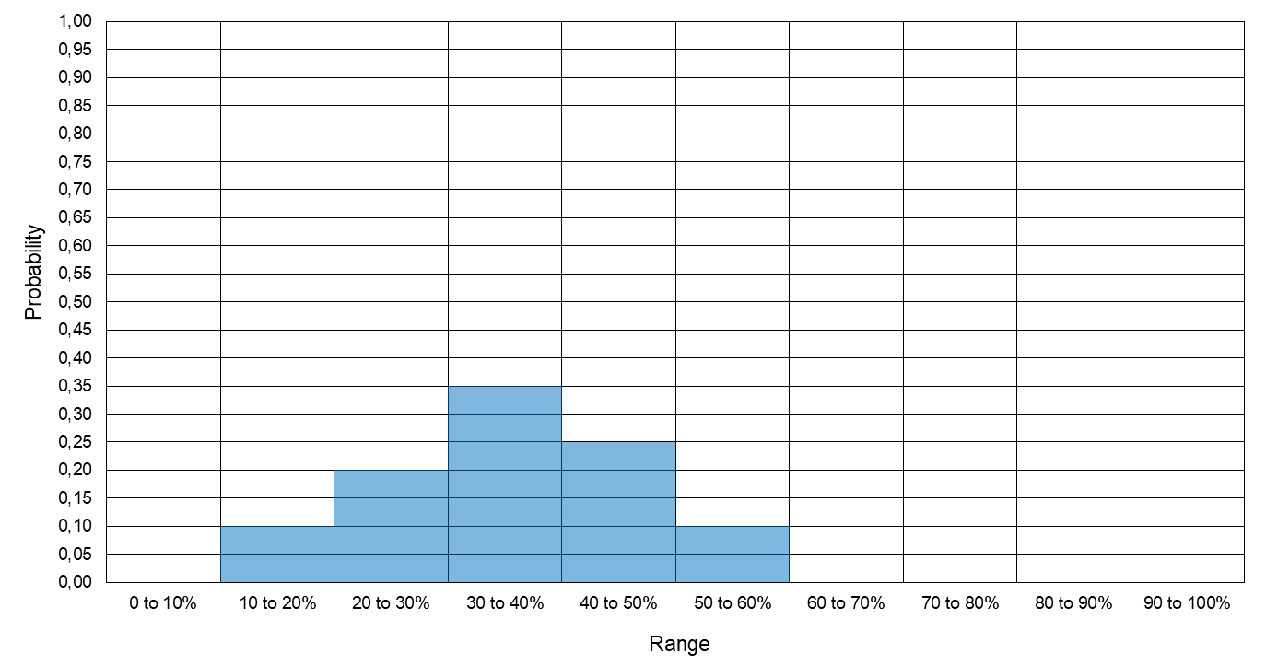
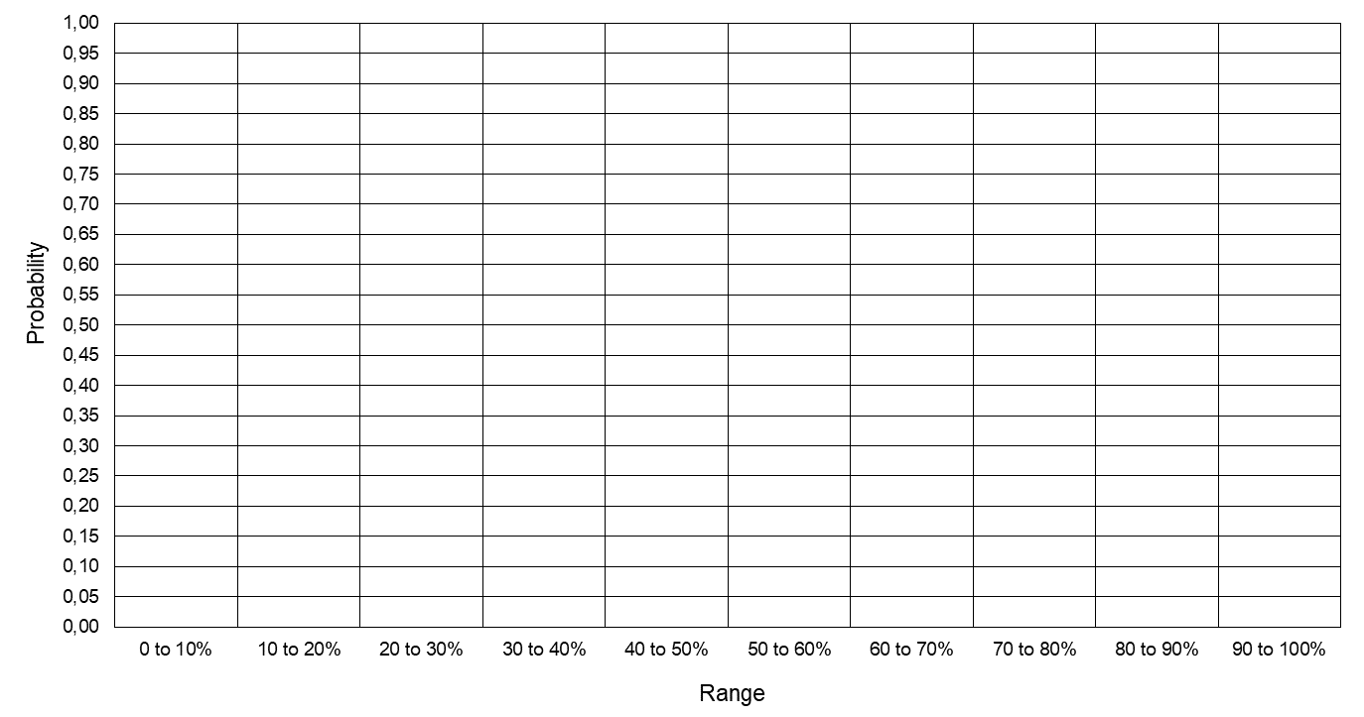
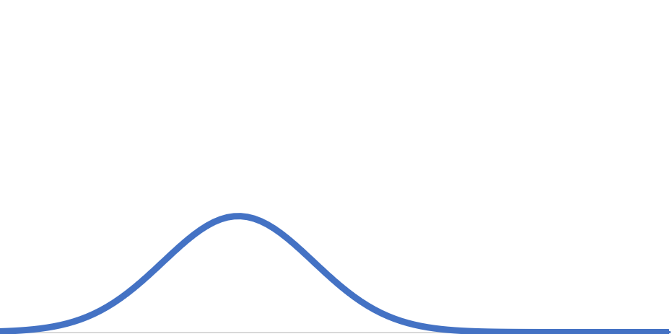
You will then be asked to complete a ‘chips and bins’ exercise for each quantity of interest.
Delete this slide if you are not using chips and bins.
10 ‘bins’, each representing a range of possible values of the quantity
You are asked to place the chips in the bins to specify your knowledge and beliefs
A probability distribution will be generated for you to review to check that this is reflective of your beliefs
20 ‘chips’, each representing a probability of 0.05 (5%)

Slide 14
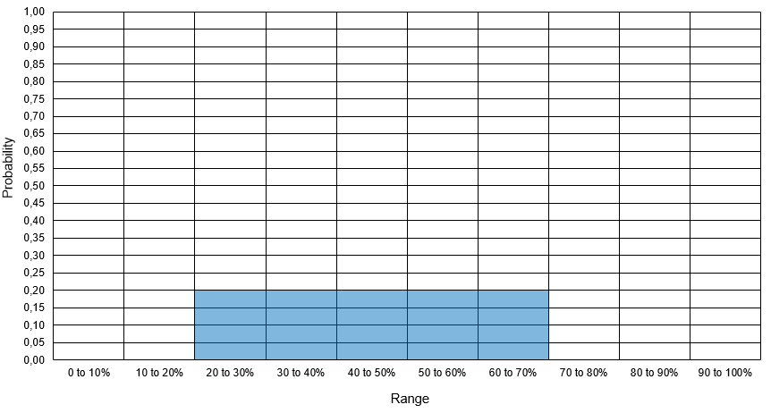
Chips and bins: Example 1.
Delete this slide if you are not using chips and bins.
Example 1
You are certain that the true value lies between 20% and 70% but it is equally likely to be any of the values in between

Slide 15
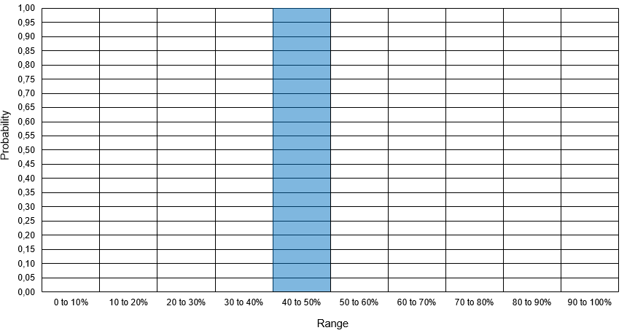
Chips and bins: Example 2.
Delete this slide if you are not using chips and bins.
Example 2
You are certain that the true value lies between 40% and 50%. No other values are possible.

Slide 16
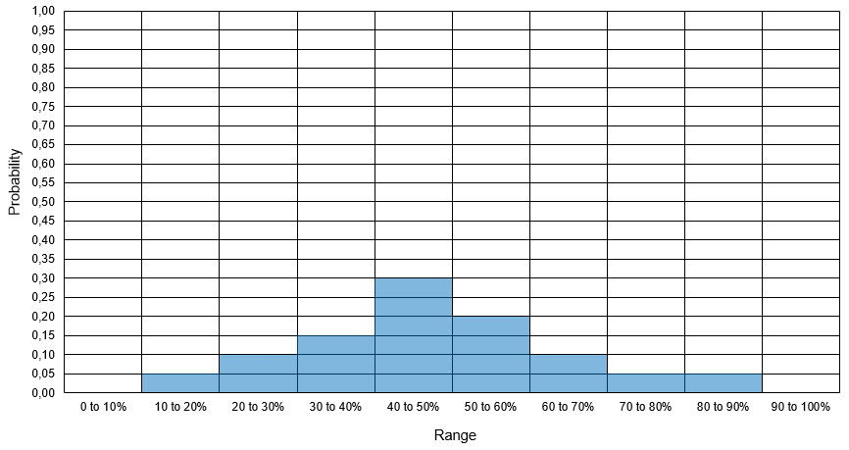
Chips and bins: Example 3.
Delete this slide if you are not using chips and bins.
Example 3
The true value is equally likely to fall within the following ranges:
<40%
40–50%
50–70%
There is a smaller chance that the true value is >70%
The true value is not less than 10%
The true value is not greater than 90%
The true value is most likely to be between 40 and 50%

Slide 17
You will then be asked to complete a ‘quartiles’ exercise for each quantity of interest.
Delete this slide if you are not using quartiles.
0.25
0.25
0.25
0.25
Note: Q₁ and Q₃ are usually much closer to M than to L or U
L
Q₁
M
Q₃
U
0%
10%
20%
30%
40%
50%
60%
70%
80%
90%
100%
LOWER PLAUSIBLE LIMIT (L)
A value such that you believe that there is a 1% probability that the true value is less than L
UPPER PLAUSIBLE LIMIT (U)
A value such that you believe that there is a 1% probability that the true value is greater than U
MEDIAN (M)
A value such that the true value is equally likely to be less than or greater than M
LOWER QUARTILE (Q₁)
A value such that it is equally likely that the true value is below Q₁ or between Q₁ and M
UPPER QUARTILE (Q₃)
A value such that you judge it equally likely that the true value is between M and Q₃ or above Q₃

Slide 18
You will then be asked to complete a ‘tertiles’ exercise for each quantity of interest.
Delete this slide if you are not using tertiles.
0.33
0.33
0.33
Note: T₁ and T₂ are usually much closer to M than to L or U
L
T₁
M
T₂
U
0%
10%
20%
30%
40%
50%
60%
70%
80%
90%
100%
LOWER PLAUSIBLE LIMIT (L)
A value such that you believe that there is a 1% probability that the true value is less than L
UPPER PLAUSIBLE LIMIT (U)
A value such that you believe that there is a 1% probability that the true value is greater than U
MEDIAN (M)
A value such that the true value is equally likely to be less than or greater than M
LOWER TERTILE (T₁)
Two values within your plausible range that divide the range of values into three equally likely intervals
UPPER TERTILE (T₂)

Slide 19
You will then be asked to complete a ‘bisection’ exercise for each quantity of interest.
Delete this slide if you are not using bisection.
0.5
0.5
L
M
U
0%
10%
20%
30%
40%
50%
60%
70%
80%
90%
100%
LOWER PLAUSIBLE LIMIT (L)
A value such that you believe that there is a 1% probability that the true value is less than L
UPPER PLAUSIBLE LIMIT (U)
A value such that you believe that there is a 1% probability that the true value is greater than U
MEDIAN (M)
A value such that the true value is equally likely to be less than or greater than M

Slide 20
Common sources of bias can be divided into cognitive biases and motivation biases.
Anchoring bias
Fixing on an initial value and failing to sufficiently adjust estimates away from it.
Challenging to eliminate.
Asking for plausible limits before the median minimizes anchoring bias.
Availability bias
Basing judgement about the probability of an event on how easily examples of an outcome come to mind.
Judgement may be biased towards more recent or prominent experiences.
Evidence brief aims to minimize this by summarizing key evidence.
Confirmation bias
Focusing on and being less critical of information that is consistent with existing beliefs and preference.
(Un)desirability bias
Overestimating the likelihood of positive outcomes (wishful thinking) or negative outcomes (precautionary thinking).
Cognitive biases
Motivation biases
Cognitive and motivational biases often lead to overconfidence (probability distributions that are too narrow).
Keeping these biases in mind during the exercise can help you to reduce their impact.

Slide 21
TOPIC | SLIDE NO.
Study Background | 4
Structured Expert Elicitation | 8
Practice Example | 21
Questions and Evidence Base | 48
Q&A | 53

Slide 22
Practice question 1
What is the mean age of today’s group of experts?

Slide 23
Lower plausible limit (L)
What is the mean age of today’s group of experts?
You are asked to first consider your lower plausible limit (L).
This is a value such that you believe there is a 1% probability that the true value is less than L.
PLEASE INPUT YOUR L.
TESTING YOUR L
Imagine that somebody gives you the true value, but it is lower than your L.
Your reaction should be that the person has misunderstood or misremembered, i.e. you are very confident that you have chosen the right range!
If you would accept that this is plausible, then you should reduce your value of L.

Slide 24
Upper plausible limit (U)
What is the mean age of today’s group of experts?
You are now asked to consider your upper plausible limit (U).
This is a value such that you believe that there is a 1% probability that the true value is greater than U.
PLEASE INPUT YOUR U.
TESTING YOUR U
Imagine that somebody gives you the true value, but it is greater than your U.
Your reaction should be that the person has misunderstood or misremembered, i.e. you are very confident that you have chosen the right range!
If you would accept that this is plausible, then you should increase your value of U.

Slide 25
Plausible range (L–U)
What is the mean age of today’s group of experts?
You now have your personal plausible range for the quantity
Please check that:
You are almost certain that the true value will lie between L and U.
You feel that any value outside this range is not plausible.
L
U

Slide 26
Chips and Bins
Delete this slide if you are not using chips and bins.
What is the mean age of today’s group of experts?
10 ‘bins’, each representing a range of possible values of the quantity
You are asked to place the chips in the bins to specify your knowledge and beliefs
Please complete the chips and bins exercise on the relevant platform as instructed
You have 20 ‘chips’, each representing a probability of 0.05 (5%)

Slide 27
Delete this slide if you are not using chips and bins.
Chips and Bins
What is the mean age of today’s group of experts?
Please check that:
You have placed all your chips
You are happy with the probability implied by the number of chips you have placed in each bin
Look at groups of bins and check that you are happy with their aggregate probabilities
Look at bins with the same numbers of chips and check that you think they are equally likely to contain the true value

Slide 28
Median (M)
Delete this slide if you are not using quartiles, tertiles or bisection.
What is the mean age of today’s group of experts?
You are now asked to consider your median (M).
You should judge it to be equally likely that the true value is below M or above M.
M should be between your plausible limits.
Consider whether it is more likely that the true value is closer to L or to U.
PLEASE INPUT YOUR M.
TESTING YOUR M
Suppose you were offered a large prize if you can guess correctly whether the true value is above or below your M.
Would you be inclined to guess above or below?
If you have a preference, then M is not your median.
If you would guess above, you should increase your M.
If you would guess below, you should decrease your M.
Adjust your M so that you do not favour guessing either above or below.

Slide 29
Lower quartile (Q₁)
Delete this slide if you are not using quartiles.
What is the mean age of today’s group of experts?
Suppose you were told that the proportion is below your M.
Can you now provide a new value (Q₁) such that the true value is equally likely to be less than or greater than Q₁?
Q₁ should be between your L and M, but it should be closer to M because:
The true value is more likely to be similar to M than to L.
Values near L are only just plausible.
PLEASE INPUT YOUR Q₁.
TESTING YOUR Q₁
Suppose you were offered a large prize for correctly guessing whether the true value is below Q₁ or between Q₁ and M.
If you would guess above, you should increase your Q₁
If you would guess below, you should decrease your Q₁
Adjust your Q₁ so that you do not favour guessing either above or below.

Slide 30
Upper quartile (Q₃)
Delete this slide if you are not using quartiles.
What is the mean age of today’s group of experts?
Suppose you were told that the proportion is above your M.
Can you now provide a new value (Q₃) such that the true value is equally likely to be less than or greater than Q₃?
Q₃ should be between your M and U, but it should be closer to M because:
The true value is more likely to be similar to M than to U.
Values near U are only just plausible.
PLEASE INPUT YOUR Q₃.
TESTING YOUR Q₃
Suppose you were offered a large prize for correctly guessing whether the true value is between M and Q₃ or above Q₃.
If you would guess above, you should increase your Q₃
If you would guess below, you should decrease your Q₃
Adjust your Q₃ so that you do not favour guessing either above or below.

Slide 31
Tertiles (T₁ and T₂)
Delete this slide if you are not using tertiles.
What is the mean age of today’s group of experts?
You are now asked to consider your lower tertile (T₁) and upper tertile (T₂).
You should judge it to be equally likely that the true value is:
Below T₁ (33% probability)
Between T₁ and T₂ (33% probability)
Above T₂ (33% probability).
PLEASE INPUT YOUR T₁ AND T₂.
TESTING YOUR TERTILES
Suppose you were offered a large prize for correctly guessing whether the true value will be below T₁, between T₁ and T₂, or above T₂.
If you would guess below T₁, you should decrease your T₁.
If you would guess between T₁ and T₂, you should move your tertiles closer together.
If you would guess above T₂, you should increase your T₂.
Adjust your tertiles so that you do not favour guessing either option.

Slide 32
Time for a 5-minute break.

Slide 33
The results of the practice exercise are shown below.
Expert probability distributions to be added here
What are the rationales for your judgements?
What are the key differences between experts? Why do these differences exist?

Slide 34
Practice question 2
What percentage of households in the UK have a pet?

Slide 35
Lower plausible limit (L)
What percentage of households in the UK have a pet?
You are asked to first consider your lower plausible limit (L).
This is a value such that you believe there is a 1% probability that the true value is less than L.
PLEASE INPUT YOUR L.
TESTING YOUR L
Imagine that somebody gives you the true value, but it is lower than your L.
Your reaction should be that the person has misunderstood or misremembered, i.e. you are very confident that you have chosen the right range!
If you would accept that this is plausible, then you should reduce your value of L.

Slide 36
Upper plausible limit (U)
What percentage of households in the UK have a pet?
You are now asked to consider your upper plausible limit (U).
This is a value such that you believe that there is a 1% probability that the true value is greater than U.
PLEASE INPUT YOUR U.
TESTING YOUR U
Imagine that somebody gives you the true value, but it is greater than your U.
Your reaction should be that the person has misunderstood or misremembered, i.e. you are very confident that you have chosen the right range!
If you would accept that this is plausible, then you should increase your value of U.

Slide 37
Plausible range (L–U)
What percentage of households in the UK have a pet?
You now have your personal plausible range for the quantity
Please check that:
You are almost certain that the true value will lie between L and U.
You feel that any value outside this range is not plausible.
L
U

Slide 38
Chips and Bins
Delete this slide if you are not using chips and bins.
What percentage of households in the UK have a pet?
10 ‘bins’, each representing a range of possible values of the quantity
You are asked to place the chips in the bins to specify your knowledge and beliefs
Please complete the chips and bins exercise on the relevant platform as instructed
You have 20 ‘chips’, each representing a probability of 0.05 (5%)

Slide 39
Delete this slide if you are not using chips and bins.
Chips and Bins
What percentage of households in the UK have a pet?
Please check that:
You have placed all your chips
You are happy with the probability implied by the number of chips you have placed in each bin
Look at groups of bins and check that you are happy with their aggregate probabilities
Look at bins with the same numbers of chips and check that you think they are equally likely to contain the true value

Slide 40
Median (M)
Delete this slide if you are not using quartiles, tertiles or bisection.
What percentage of households in the UK have a pet?
You are now asked to consider your median (M).
You should judge it to be equally likely that the true value is below M or above M.
M should be between your plausible limits.
Consider whether it is more likely that the true value is closer to L or to U.
PLEASE INPUT YOUR M.
TESTING YOUR M
Suppose you were offered a large prize if you can guess correctly whether the true value is above or below your M.
Would you be inclined to guess above or below?
If you have a preference, then M is not your median.
If you would guess above, you should increase your M.
If you would guess below, you should decrease your M.
Adjust your M so that you do not favour guessing either above or below.

Slide 41
Lower quartile (Q₁)
Delete this slide if you are not using quartiles.
What percentage of households in the UK have a pet?
Suppose you were told that the proportion is below your M.
Can you now provide a new value (Q₁) such that the true value is equally likely to be less than or greater than Q₁?
Q₁ should be between your L and M, but it should be closer to M because:
The true value is more likely to be similar to M than to L.
Values near L are only just plausible.
PLEASE INPUT YOUR Q₁.
TESTING YOUR Q₁
Suppose you were offered a large prize for correctly guessing whether the true value is below Q₁ or between Q₁ and M.
If you would guess above, you should increase your Q₁
If you would guess below, you should decrease your Q₁
Adjust your Q₁ so that you do not favour guessing either above or below.

Slide 42
Upper quartile (Q₃)
Delete this slide if you are not using quartiles.
What percentage of households in the UK have a pet?
Suppose you were told that the proportion is above your M.
Can you now provide a new value (Q₃) such that the true value is equally likely to be less than or greater than Q₃?
Q₃ should be between your M and U, but it should be closer to M because:
The true value is more likely to be similar to M than to U.
Values near U are only just plausible.
PLEASE INPUT YOUR Q₃.
TESTING YOUR Q₃
Suppose you were offered a large prize for correctly guessing whether the true value is between M and Q₃ or above Q₃.
If you would guess above, you should increase your Q₃
If you would guess below, you should decrease your Q₃
Adjust your Q₃ so that you do not favour guessing either above or below.

Slide 43
Tertiles (T₁ and T₂)
Delete this slide if you are not using tertiles.
What percentage of households in the UK have a pet?
You are now asked to consider your lower tertile (T₁) and upper tertile (T₂).
You should judge it to be equally likely that the true value is:
Below T₁ (33% probability)
Between T₁ and T₂ (33% probability)
Above T₂ (33% probability).
PLEASE INPUT YOUR T₁ AND T₂.
TESTING YOUR TERTILES
Suppose you were offered a large prize for correctly guessing whether the true value will be below T₁, between T₁ and T₂, or above T₂.
If you would guess below T₁, you should decrease your T₁.
If you would guess between T₁ and T₂, you should move your tertiles closer together.
If you would guess above T₂, you should increase your T₂.
Adjust your tertiles so that you do not favour guessing either option.

Slide 44
Time for a 5-minute break.

Slide 45
The results of the practice exercise are shown below.
Expert probability distributions to be added here
What are the rationales for your judgements?
What are the key differences between experts? Why do these differences exist?

Slide 46
TOPIC | SLIDE NO.
Study Background | 4
Structured Expert Elicitation | 8
Practice Example | 21
Questions and Evidence Base | 48
Q&A | 53

Slide 47
Quantities to be elicited
Summary of quantities to be elicited

Slide 48
Dependence between quantities
Delete this slide if not relevant.
Summary of dependence between quantities and how this will be handled

Slide 49
Definitions and assumptions
KEY DEFINITIONS
KEY ASSUMPTIONS
Add a list of key definitions used for the purposes of this exercise.
Add a list of key assumptions used for the purposes of this exercise.

Slide 50
Summary of evidence base
Summary of evidence base

Slide 51
TOPIC | SLIDE NO.
Study Background | 4
Structured Expert Elicitation | 8
Practice Example | 21
Questions and Evidence Base | 48
Q&A | 53

Slide 52
Thanks for listening.
Any questions?

